Slide 1

Used car price prediction model
Samira Mohammadzadeh
Vince Sy
Shadi Salama
Shadi Askarzadeh

Slide 2
Project Overview
Data Source:
Data Size: 800K+
Sample Data: 1997-2018 used car prices for Honda, Toyota and Nissan
Technology used:
HTML/CSS/Bootstrap
Python Pandas
Spark
Matplotlib
Sklearn (LinearRegression , MinMaxscaler, train_test_split, LableEncode)
Flask
AWS
Prediction Model : RandomForest (RF) score:
Infrastructure: AWS EC2 Elastic Beans

Slide 3



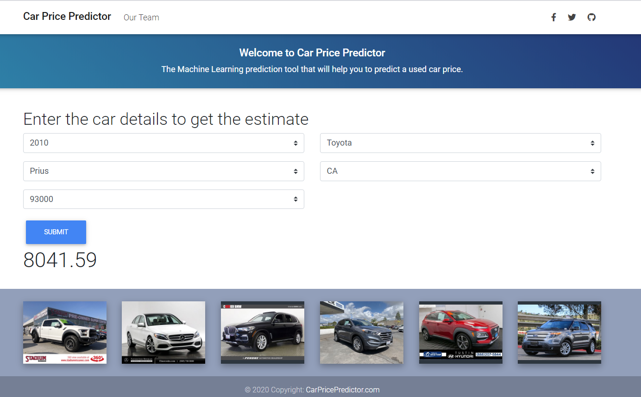


HTML/CSS Bootstrap
machine learning
Random Forest

Slide 4
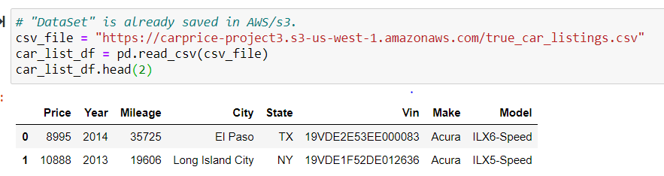
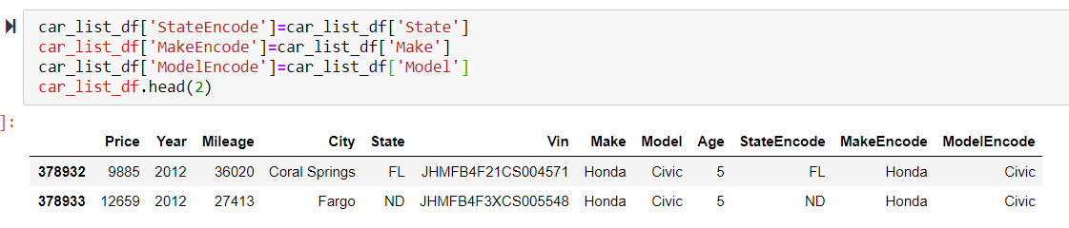
Data Cleaning

Slide 5
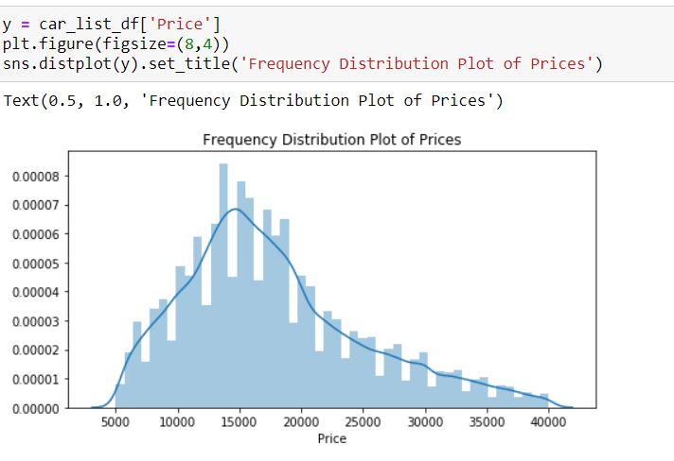
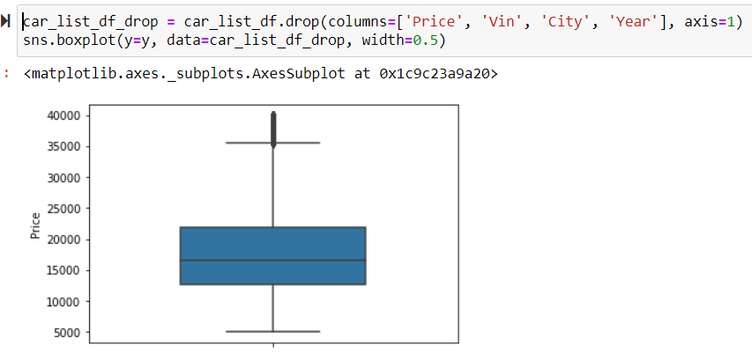
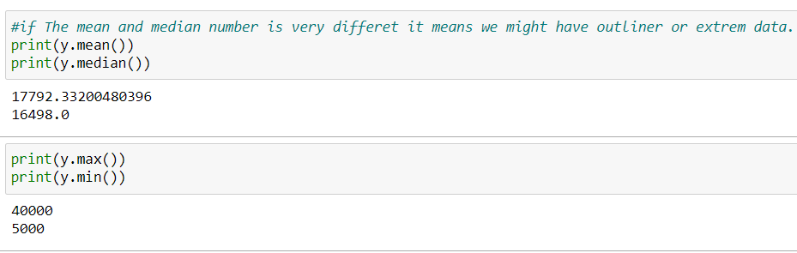
Data Visualization

Slide 6
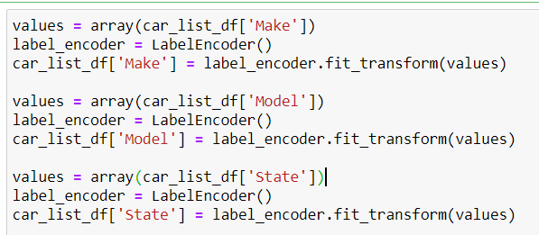
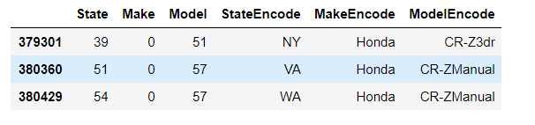
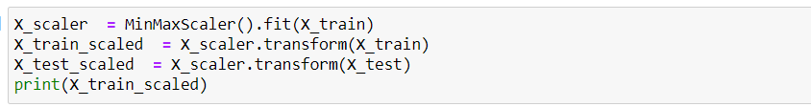
Machine Learning

Slide 7
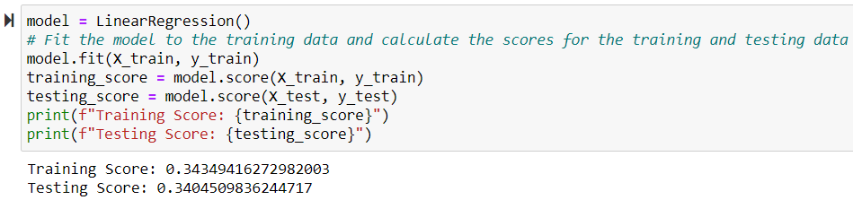
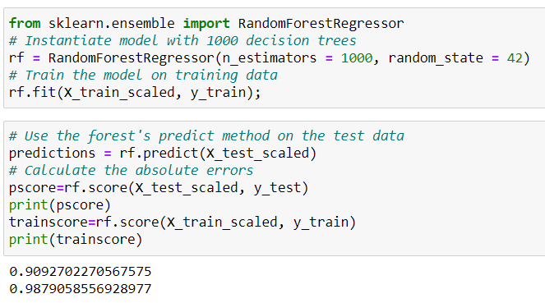
Choose our Model

Slide 8
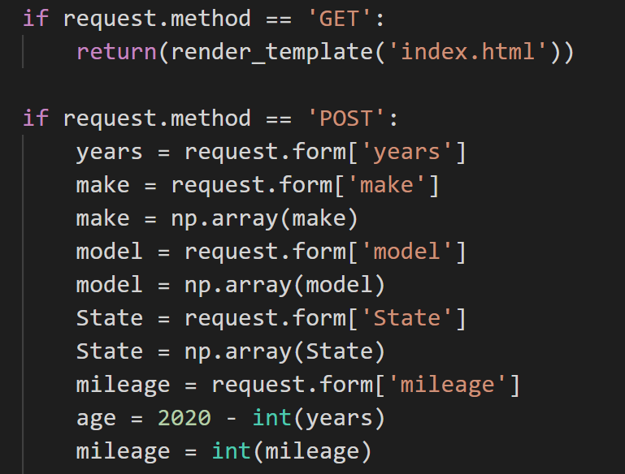
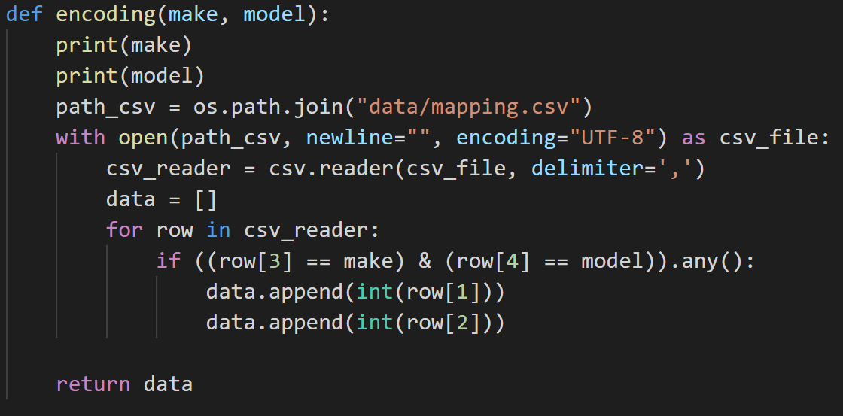
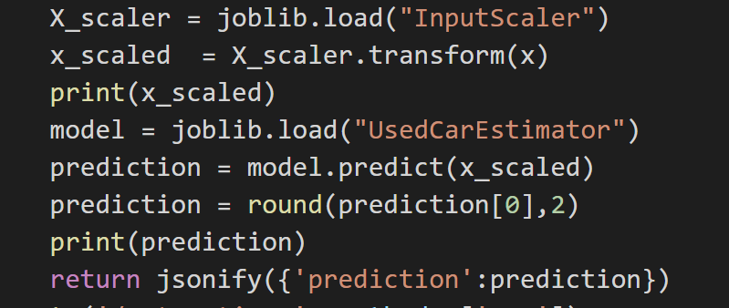
Integration-Flask

Slide 9
UI/UX– HTML/CSS/Bootstrap

Slide 10
Thank you

